Slide 1
Review of First Sprint
by Bohdan Antoniak
Lv-553.SET

Slide 2
Agenda
Test Execution and Defect Logging
Test Design Techniques
C# Program

Slide 3

First week overview(Test Execution and Defect Logging)
Scope:
User Stories: 4
Test Cases: 24
Planned tasks:
Test Case execution, OMS v.2.
Defects logging.
Confirmation testing, OMS v.5.
Regression testing, OMS v.5.
Defects tracking.
Prepare Defect Statistic.

Slide 4
Testing Summary, OMS v.2
Test cases “Passed”: 10 (42%)
Test cases “Failed”: 14 (58%)
Test cases “Blocked”: 0 (0%)
Defect Found: 22

Slide 5
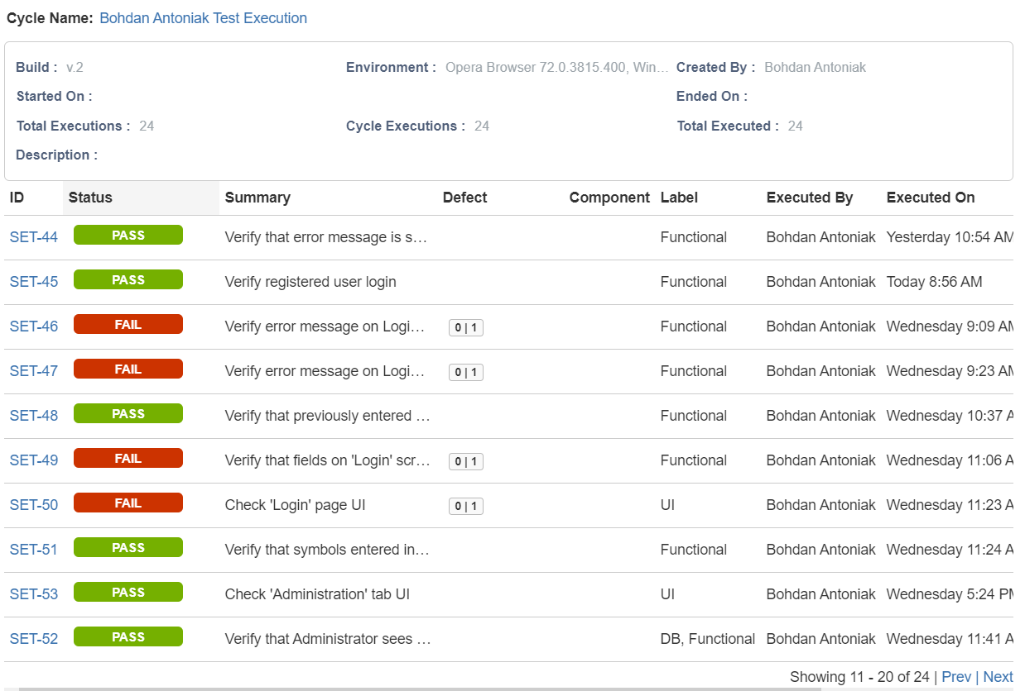
Testing Summary, OMS v.2

Slide 6
Testing Summary, OMS v.5, Confirmation
Test cases “Passed”: 3 (21%)
Test cases “Failed”: 11 (79%)
Test cases “Blocked”: 0 (0%)
New Defects Found: 14

Slide 7
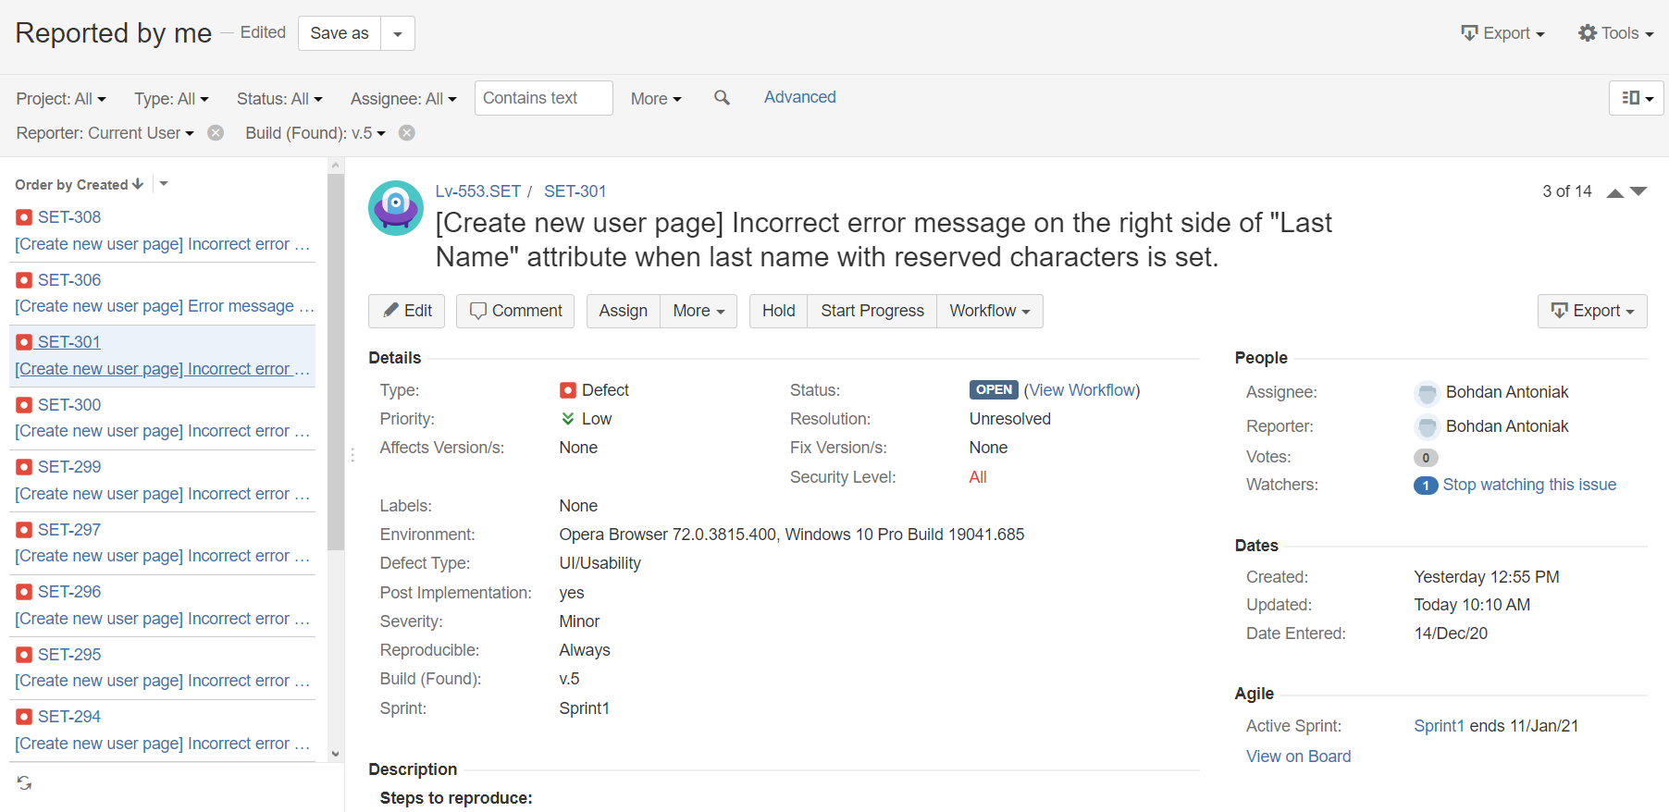
Testing Summary, OMS v.5, Confirmation

Slide 8
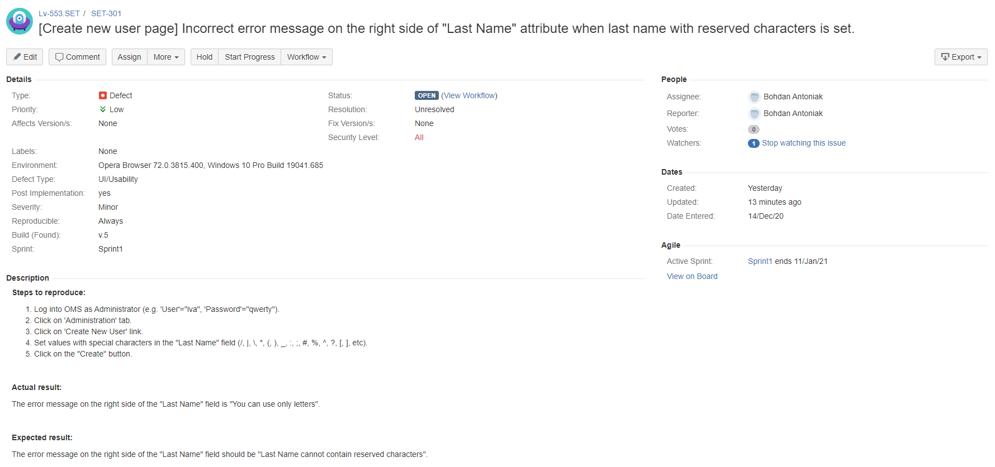
Testing Summary, OMS v.5, Confirmation

Slide 9
Testing Summary, OMS v.5, Regression
Test cases “Passed”: 9 (90%)
Test cases “Failed”: 1 (10%)
Test cases “Blocked”: 0 (0%)
New Defects Found: 1

Slide 10
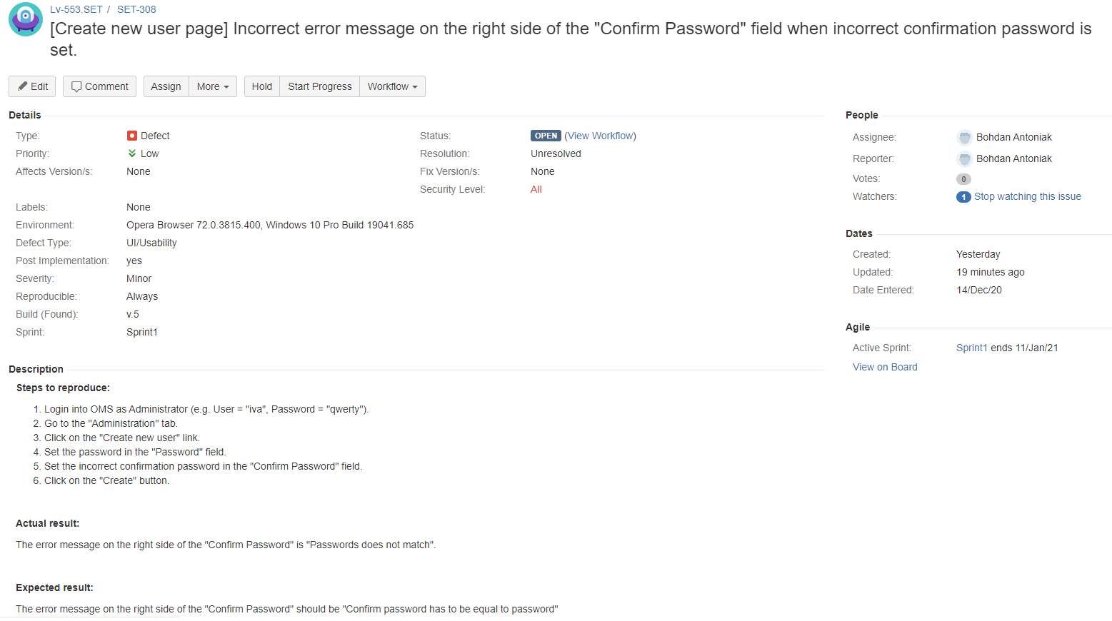
Testing Summary, OMS v.5, Regression

Slide 11
Defect Statistic by Priority

Slide 12
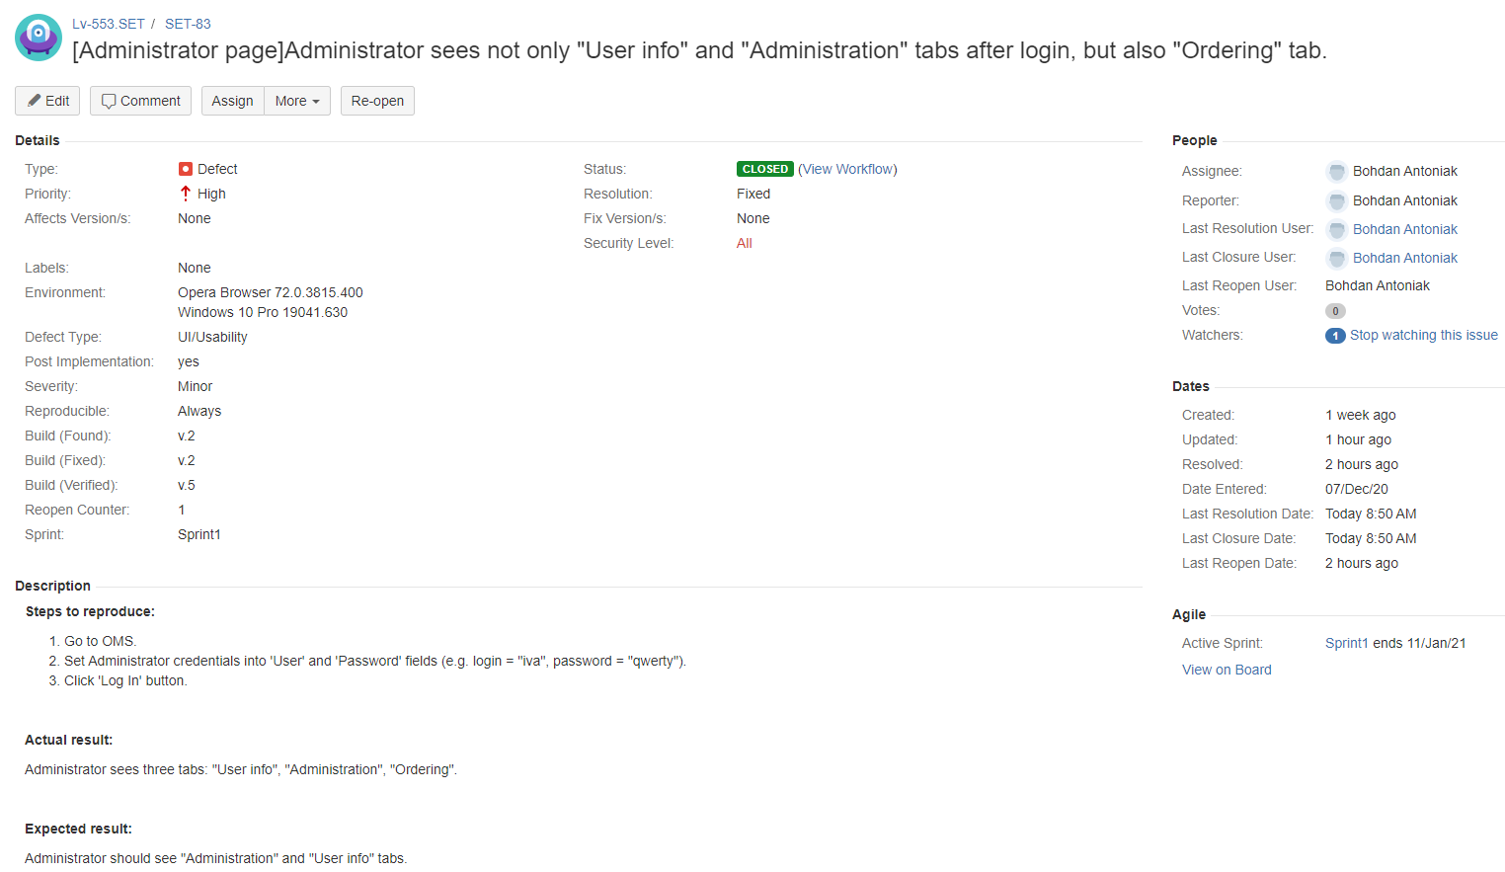
Defect Statistic by Priority

Slide 13
Opened Defect Statistic(by Priority)

Slide 14
Opened Defect Statistic(by Severity)

Slide 15
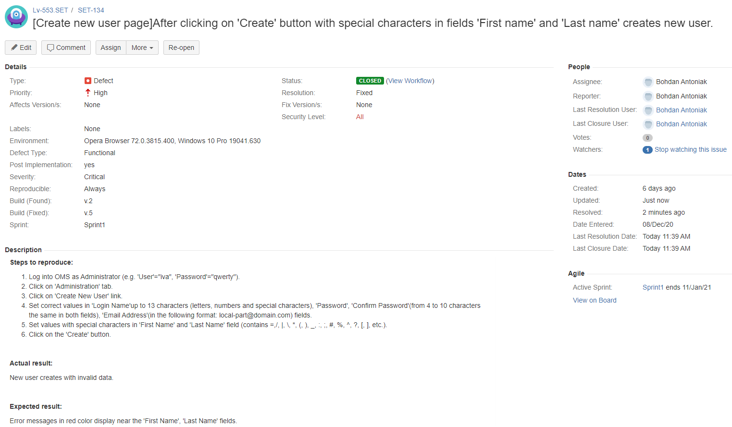
Opened Defect Statistic(by Severity)

Slide 16
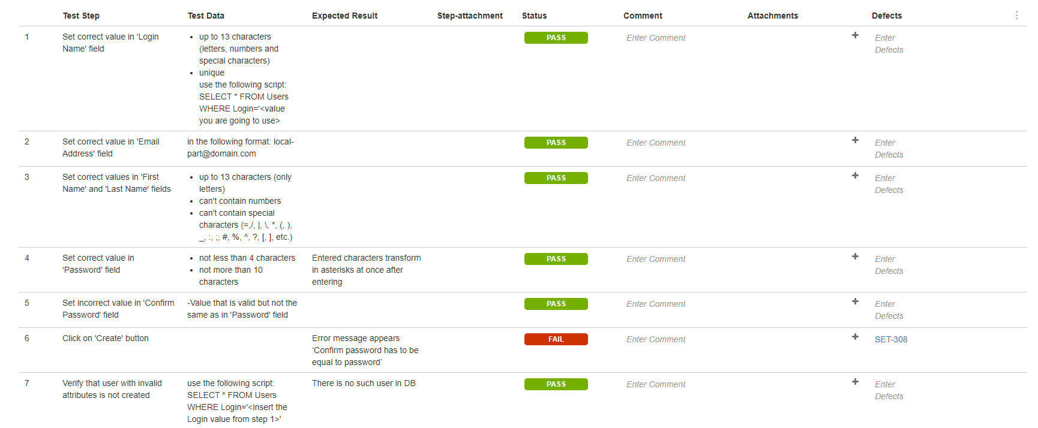
Test Case Execution Example

Slide 17

Third week overview(Test Design Techniques)
Scope: use Test Design Techniques on different tasks.
Planned tasks:
Test Design Techniques.
Equivalence Partitioning Technique.
Boundary Values Analysis Technique.
Decision table Technique.
State transition Technique.

Slide 18

Test Design Techniques
Test Design Techniques – set of methods, approaches that determine how to test certain functionality, which input and output data to choose to optimize the testing of a particular part of a product.

Slide 19
Equivalence Partitioning and Boundary Values Analysis
Equivalence partitioning - a black-box test design technique in which test cases are designed to execute representatives from equivalence partitions. Equivalence partitioning divides data into partitions (also known as equivalence classes) in such a way that all the members of a given partition are expected to be processed in the same way. There are equivalence partitions for both valid and invalid values. In principle test cases are designed to cover each partition at least once.
Boundary Value Analysis - a black box test design technique in which test cases are designed based on boundary values. So BVA divides data into partitions, like EP, but tests should be written to cover each boundary value in every partition.

Slide 20
Equivalence Partitioning and Boundary Values Analysis
Task: in a system designed to work out the tax to be paid: An employee has $1000 of salary tax free. The next $500 is taxed at 10%. The next $4000 is taxed at 22%. Any further amount is taxed by 40%. Salary cannot be larger than $6000.
 | Invalid | Valid for tax free | Valid for 10% tax | Valid for 22% tax | Valid for 40% tax | Invalid
Class | <=$0, characters, special symbols | $1 - $1000 | $1001 - $1500 | $1501 - $5500 | $5501 - $6000 | >=$6001, characters, special symbols
EP | -$1200 | $322 | $1440 | $2755 | $5810 | $7000
BVA | 0$ | $1, $1000 | $1001, $1500 | $1501, $5500 | $5501, $6000 | $6001

Slide 21
Equivalence Partitioning and Boundary Values Analysis
# | Condition | Expected result
1 | Put values `1$`, `256$`, `1000$` into input field. | Message appears “Tax to be paid by employee: 0%”.
2 | Put values `1001$`, `1350$`, `1500$` into input field. | Message appears “Tax to be paid by employee: 10%”.
3 | Put values `1501$`, `3600$`, `5500$` into input field. | Message appears “Tax to be paid by employee: 22%”.
4 | Put values `5501$`, `5780$`, `6000$` into input field. | Message appears “Tax to be paid by employee: 40%”.
5 | Put values `6800$`, ` -+=#$%^`, `-1200$`, `0$`, `abcABC` into input field or leave it empty. | Error message appears “You have entered an incorrect value for the amount of employee salary”.

Slide 22
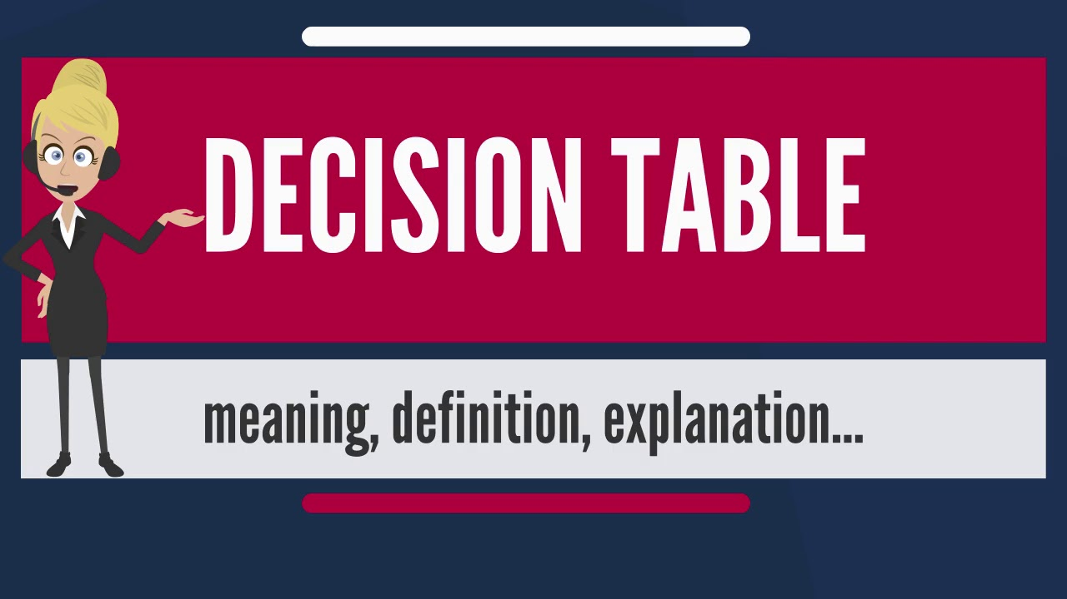
Decision table
Decision table – test design technique, which involves building tables based on the options that we have at the entrance. That means, when we have a different number of conditions, and depending on how these conditions are combined, we have different results. The table is constructed, depending on what result we will receive at coincidence of each of conditions.

Slide 23
Decision table
Task: you take a loan in a bank. The bank gives you loan application, where you can enter the amount of the monthly re-payment or the number of years you want to take to pay it back (the term of the loan). You should infill only one of the proposed fields. If you enter both, then you will get an error message.
Clarification: how the result will be present? Will it appear in other field or presented by message?
Product Owner: the result will be present by message.

Slide 24
Decision table
Causes(inputs) | R1 | R2 | R3 | R4
Infill the amount of the monthly re-payment? | Y | Y | N | N
Infill the term of the loan? | Y | N | Y | N
Effects(Outputs)
Positive message |  | + | +
Negative message | + |  |  | +

Slide 25
Decision table
# | Condition | Expected result
1 | Person puts correct value into the amount of the monthly re-payment field. | Message appears “Now you have a loan for **** term.”.
2 | Person puts correct value into the term of the loan field. | Message appears “Re-payment every month is: ***$.”.
3 | Person puts correct value into the term of the loan field and into the amount of the monthly re-payment field. | Error message appears “You have entered incorrect values for the term of the loan or for the amount of the monthly re-payment field”.
4 | Leave fields empty. | Error message appears “You have entered incorrect values for the term of the loan or for the amount of the monthly re-payment field”.

Slide 26
State transition diagram
State transition diagram – test design technique in which test cases are developed on the basis of a diagram that simulates events that cause the system to transition from one state to another.
Task: customer chooses Arabica coffee from coffee machine. He selects specific sort of coffee (in this case Arabica), and enters money. If not enough money is entered, then machine will ask to enter more. If amount of money is ok, then machine will start doing coffee. If Arabica coffee is available, then customer will get coffee and his change in a minute. If there is no selected sort of coffee, then customer will get proper message and his money back.

Slide 27
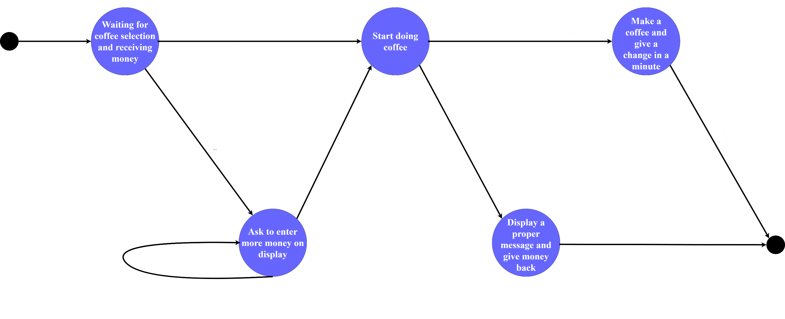
State transition diagram

Slide 28
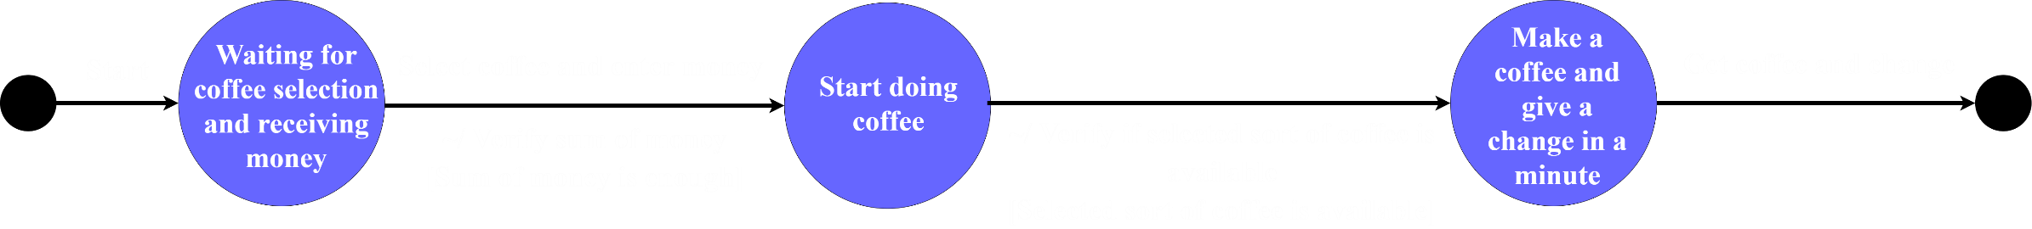
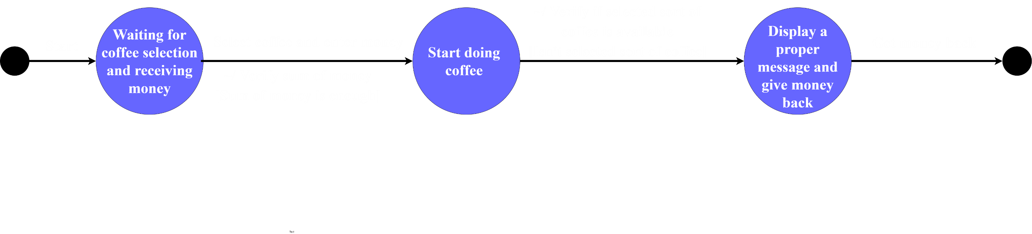
State transition diagram
1. Verify if user will get coffee and change back if he enters available sort of coffee and give enough money.
2. Verify if user will get money back if he enters unavailable sort of coffee and give enough money.

Slide 29
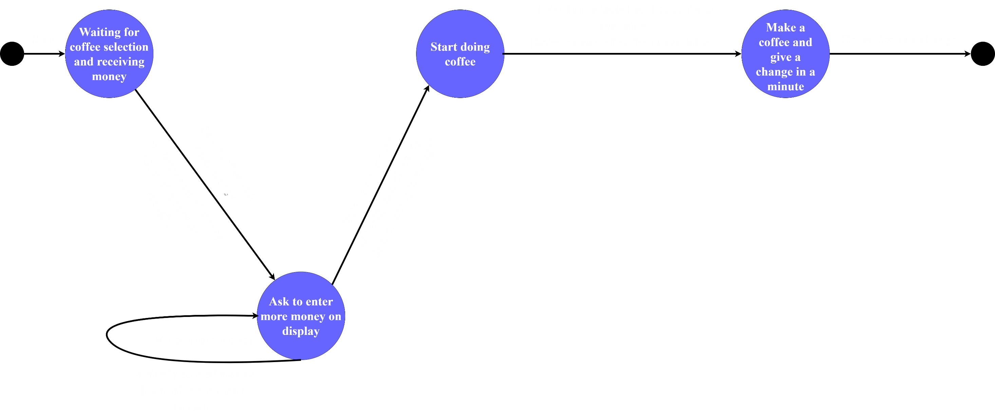
State transition diagram
3. Verify if user will get coffee and change if he enters sort of coffee, that is available, also enough money in the second attempt.

Slide 30
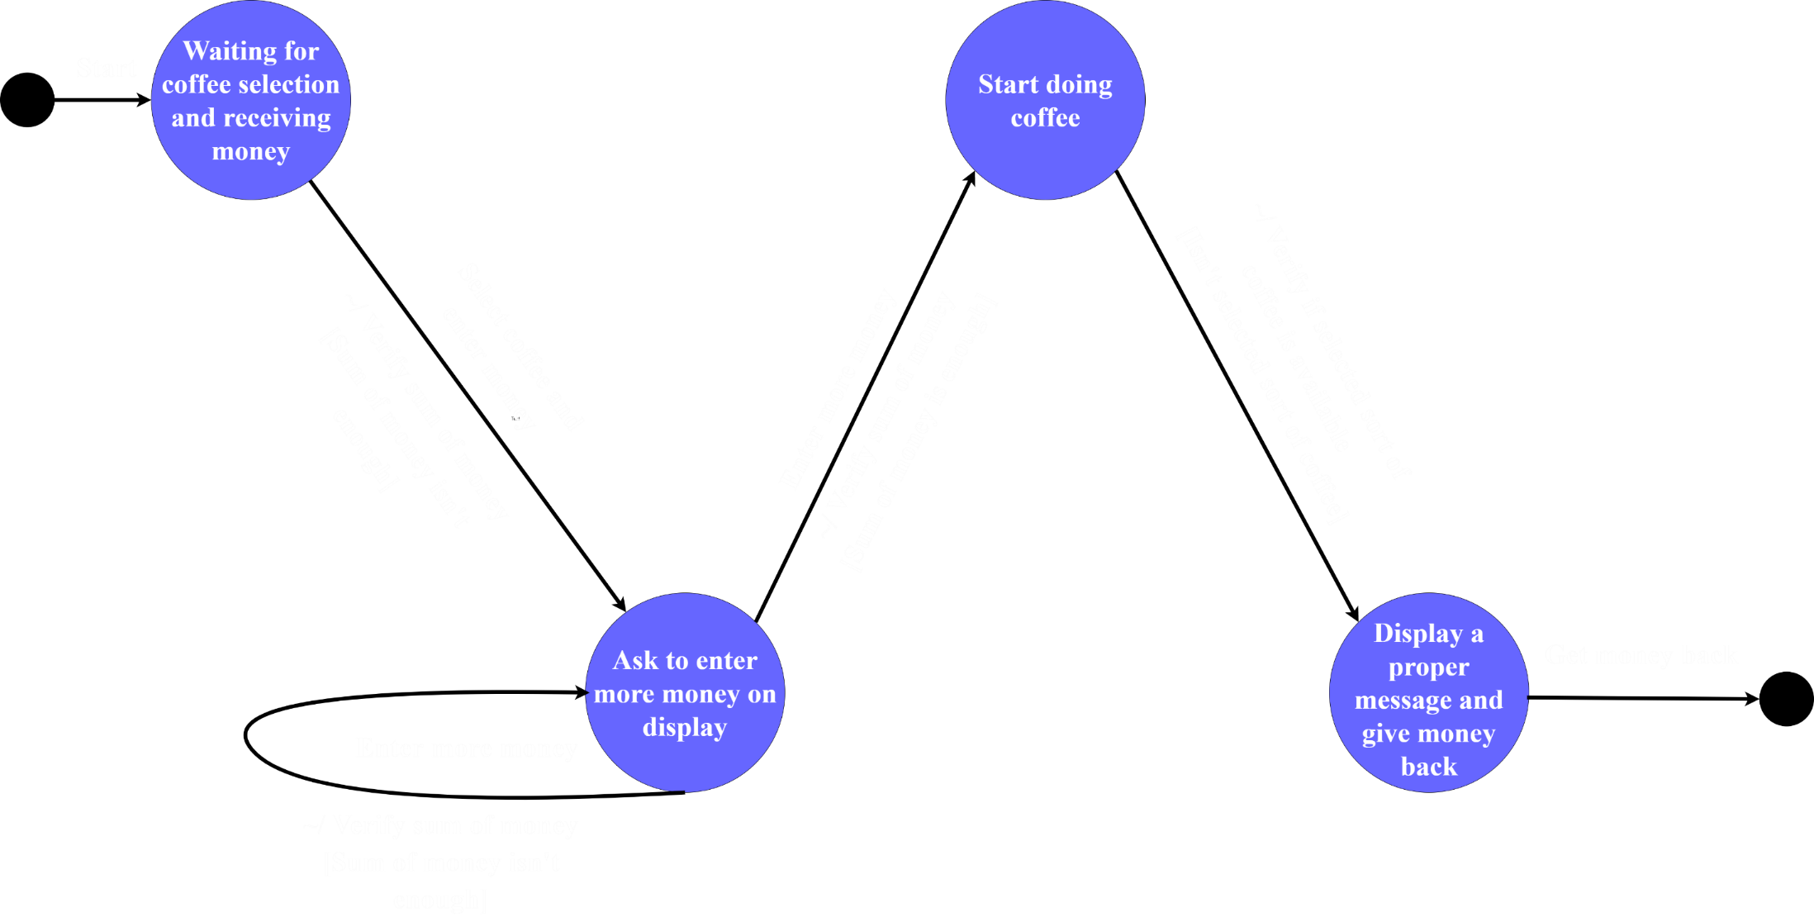
State transition diagram
4. Verify if user will get money back if he enters sort of coffee, that is unavailable, also enough money in the second attempt.

Slide 31

Fourth week overview(C# Program)
Scope: design task of program and develop the program.
Planned tasks:
Design task.
Develop program.

Slide 32
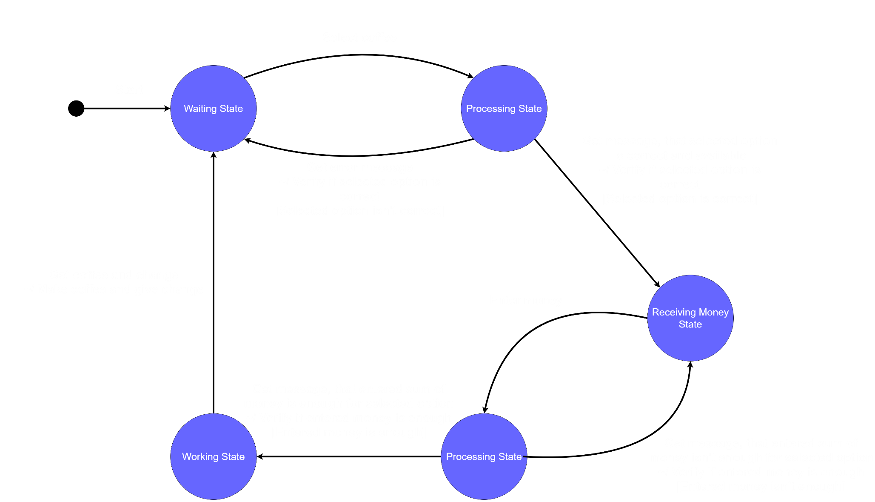
Fourth week overview(C# Program)

Slide 33


